Slide 1
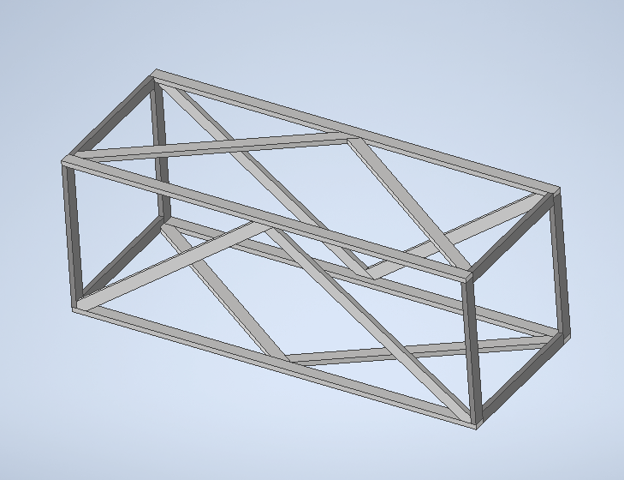
Front Leg x2
3 2x4x8
6 2x4x10
4 2x4x12
Very important to be using the right pieces and board sizes!!! Please keep track and label boards as you cut!!

Slide 2
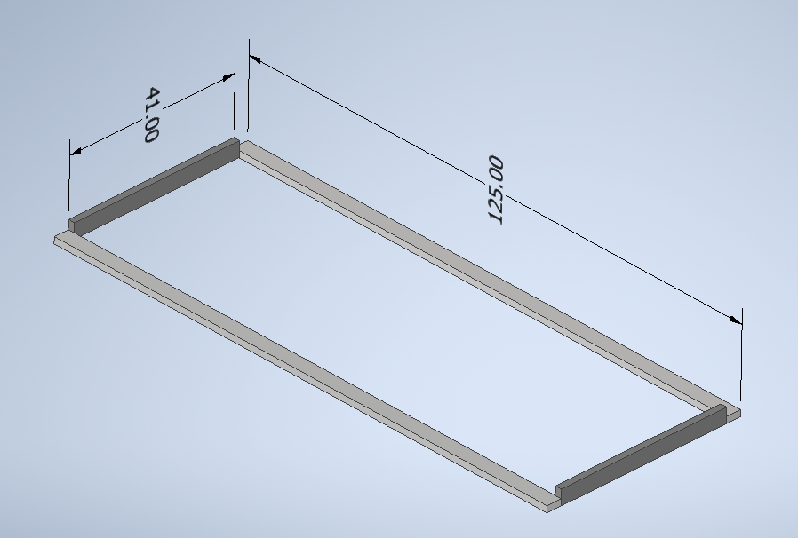
(2) 2x4x12
(2) 10’5”
(2) 2x4x10
(2) 3’5”
  Cut a 41” from two separate 10’ boards NOT the same one. Save 79” leftover pieces
Very important to be using the right pieces and board sizes!!! Please keep track and label boards as you cut!!

Slide 3
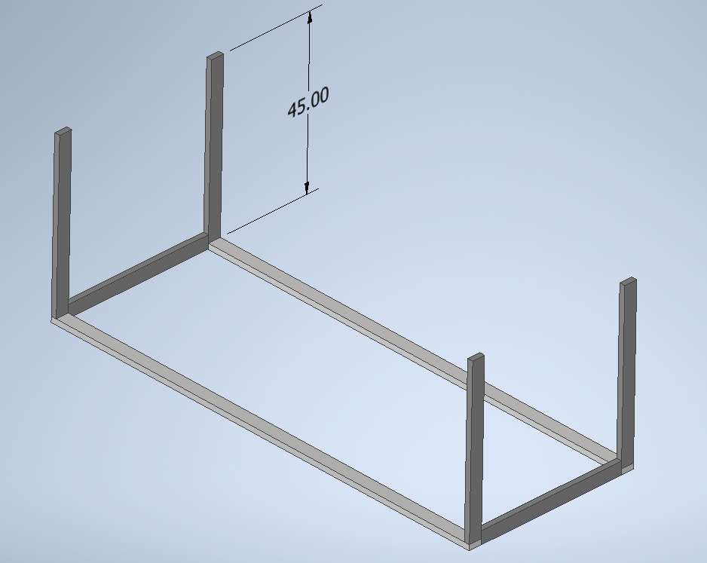
(1) 2x4x8
(2) 3’9”
  cut 2 45” from one 8’ board
(2) 2x4x10
(2) 3’9”
  Cut a 45” from two separate 10’ boards NOT the same one. Save 75” leftover pieces
Very important to be using the right pieces and board sizes!!! Please keep track and label boards as you cut!!

Slide 4
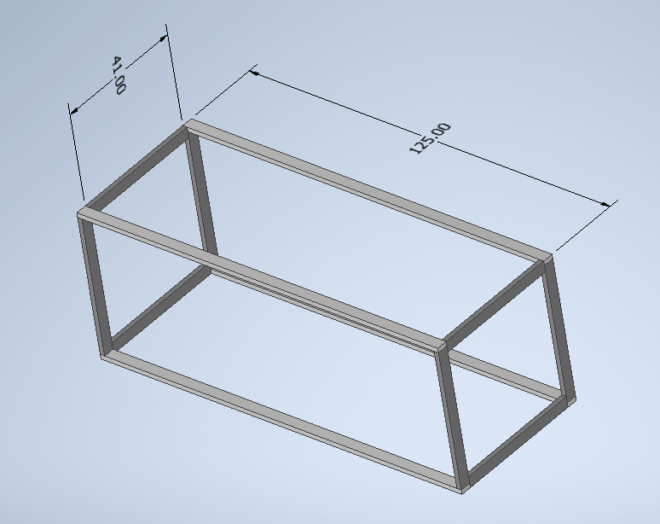
(2) 2x4x12
(2) 10’5”
(2) 2x4x10
(2) 3’5”
  Cut a 41” from two separate 10’ boards NOT the same one. Save 79” leftover pieces
Very important to be using the right pieces and board sizes!!! Please keep track and label boards as you cut!!

Slide 5
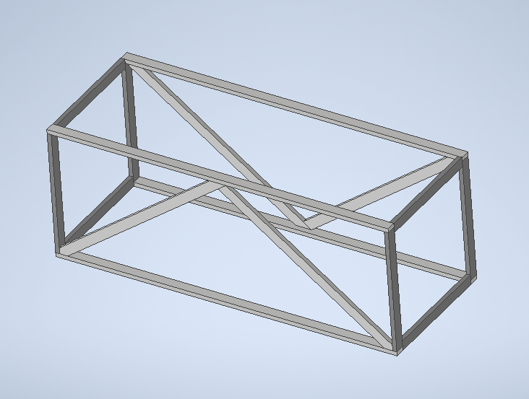
(2) 2x4x8
(2) long slants
(2) 75” leftovers
(2) short slants
Very important to be using the right pieces and board sizes!!! Please keep track and label boards as you cut!!

Slide 6
(4) 79” leftovers
(4) slants
Very important to be using the right pieces and board sizes!!! Please keep track and label boards as you cut!!

